Slide 1
Retail Analytics using Sqoop, HDFS, and Hive
Big DATA analytics
Chittoor Vamsi
S20190020208

Slide 2
Business Overview
Retail Analytics
Retail analytics is the process of delivering analytical data on inventory levels, supply chain movement, customer demand, sales, and other important factors for marketing and procurement choices.
Demand and supply data analytics may be utilized to manage procurement levels as well as make marketing decisions.
Retail analytics provides us with precise consumer insights and insights into the organization's business and procedures, as well as the scope and need for development.

Slide 3
Aside from inventory management, many retailers employ analytics to determine customer patterns and shifting preferences by merging various sources.
Businesses may discover developing trends, and better predict them by combining sales data with a range of criteria. This is strongly related to marketing functions, which also benefit from analytics.
Companies may use retail analytics to strengthen their marketing strategies by better grasping individual preferences and gaining more detailed data.
They may design strategies that focus on people and have a greater success rate by combining demographic data with information such as purchasing patterns, preferences, and purchase history.

Slide 4
In this, we will be utilizing Walmart store sales data to perform analysis and answer the following questions:
Which store has a minimum and maximum sales?
Find out location of store using Store ID
Which store has a maximum standard deviation?
Which store/s has an excellent quarterly growth rate in Q3'2012?
Find out holidays which have higher sales than the mean sales in non-holiday season for all stores together.

Slide 5
Dataset Description
The Walmart Store sales dataset consists of 6436 data points, including the following parameters:
Store
Date
Weekly_Sales
Holiday_Flag
Temperature
Fuel_Price
CPI
Unemployment

Slide 6
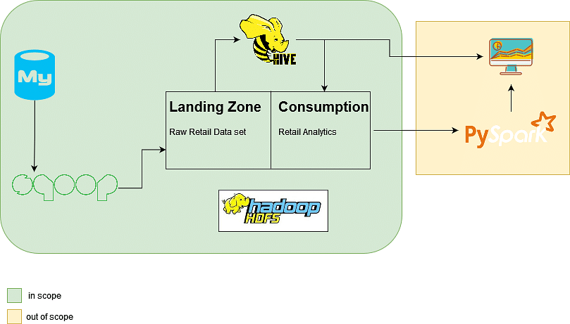
Architecture

Slide 7
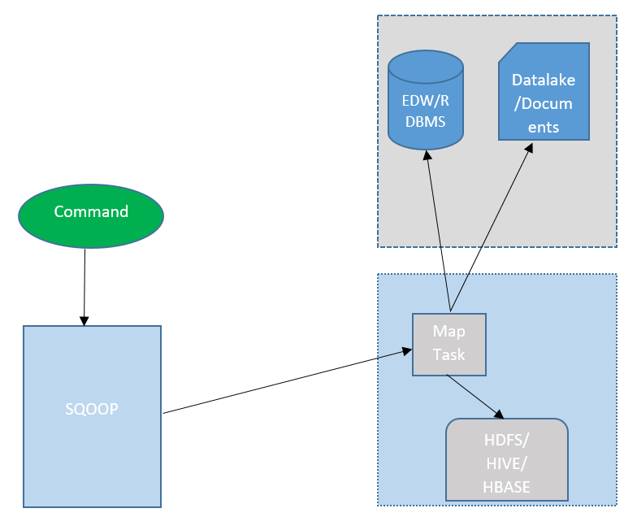
Sqoop Architecture

Slide 8
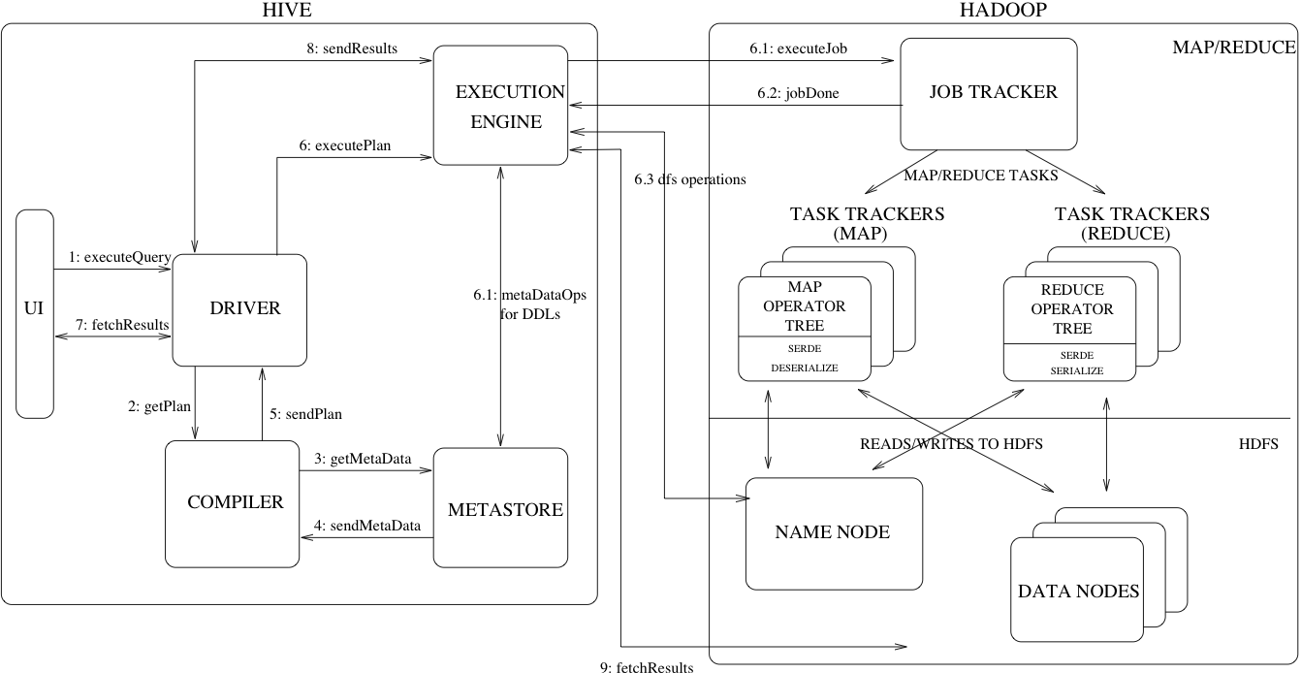
Hive Architecture

Slide 9
Migrate data from RDBMS to Hive using Sqoop
We will have two layers in Hive
Landing zone : Raw retail dataset (same as the one in MySQL)
Consumption zone : After we have performed some transformations and cleaning of data the
data that is ready to make dashboards and make machine learning models
using PySpark or any other machine learning platform.

Slide 10
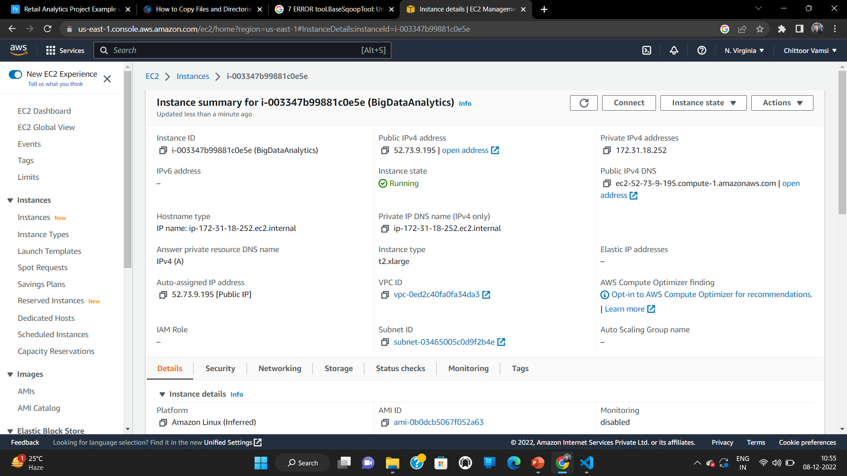
Working on AWS
Creating an EC2 instance of t2.xlarge with 4 vCPU and 1GiB memory
Storage configuration of 32 GiB General Purpose SSD( gp2 )

Slide 11
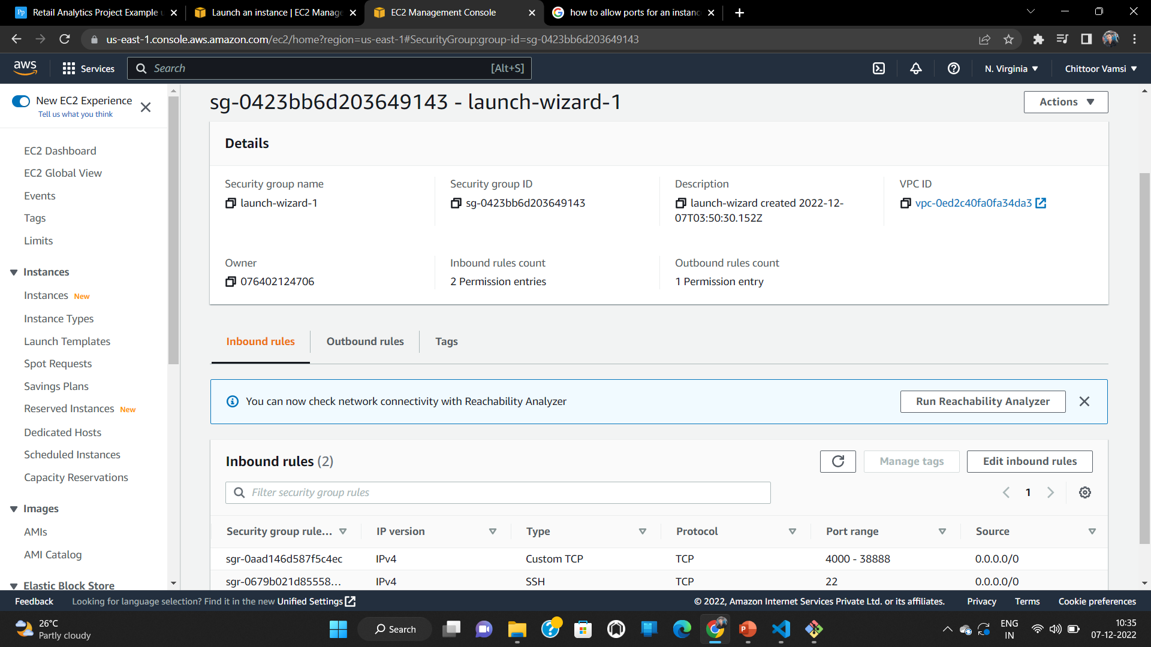
Allow ports 4000 - 38888

Slide 12
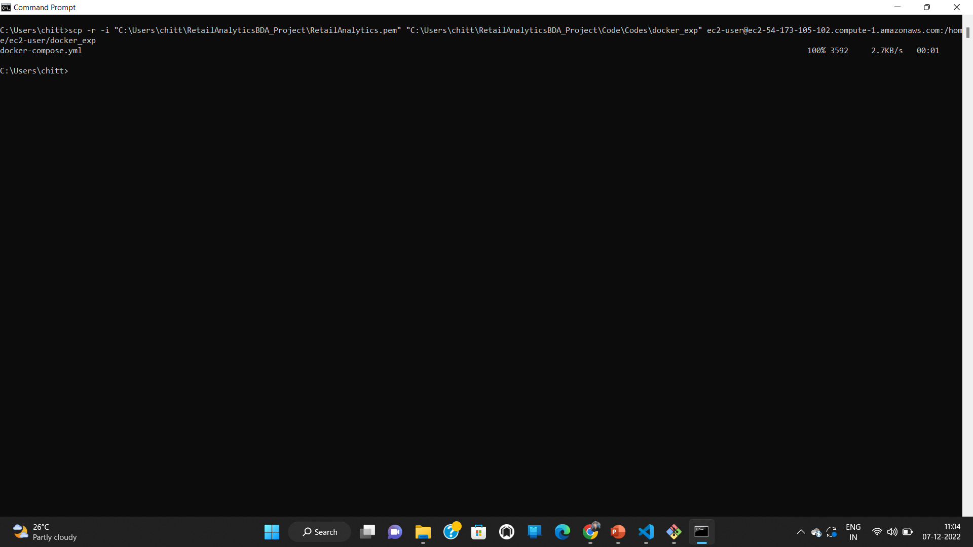
Copy docker compose file from local to EC2

Slide 13
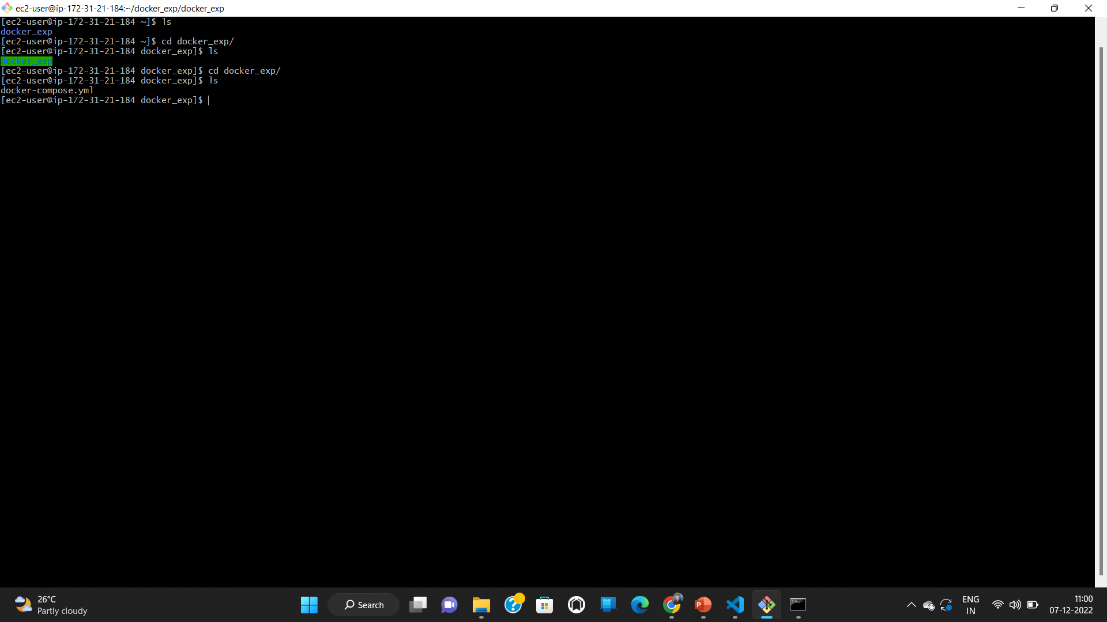
docker_exp copied to ec2 instance

Slide 14
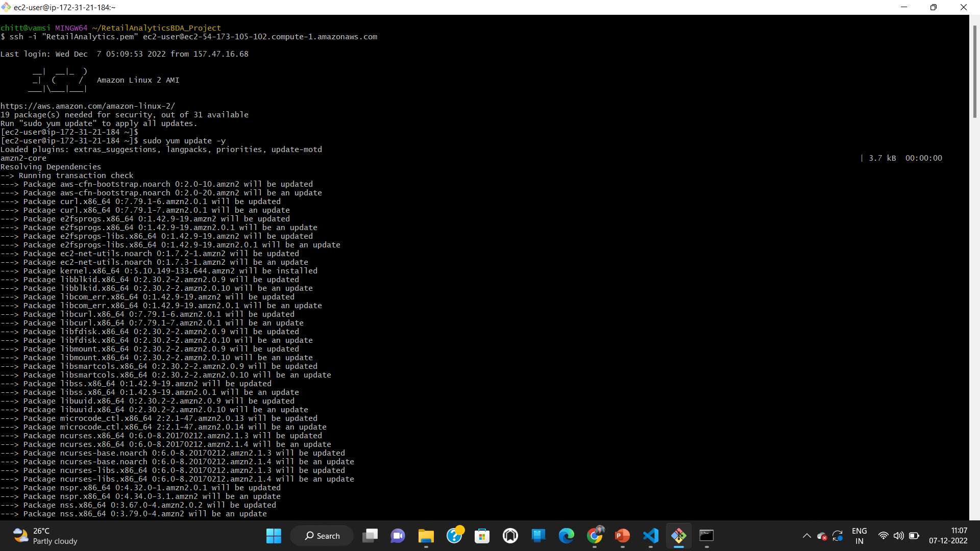
Install and setup docker
sudo yum update -y

Slide 15
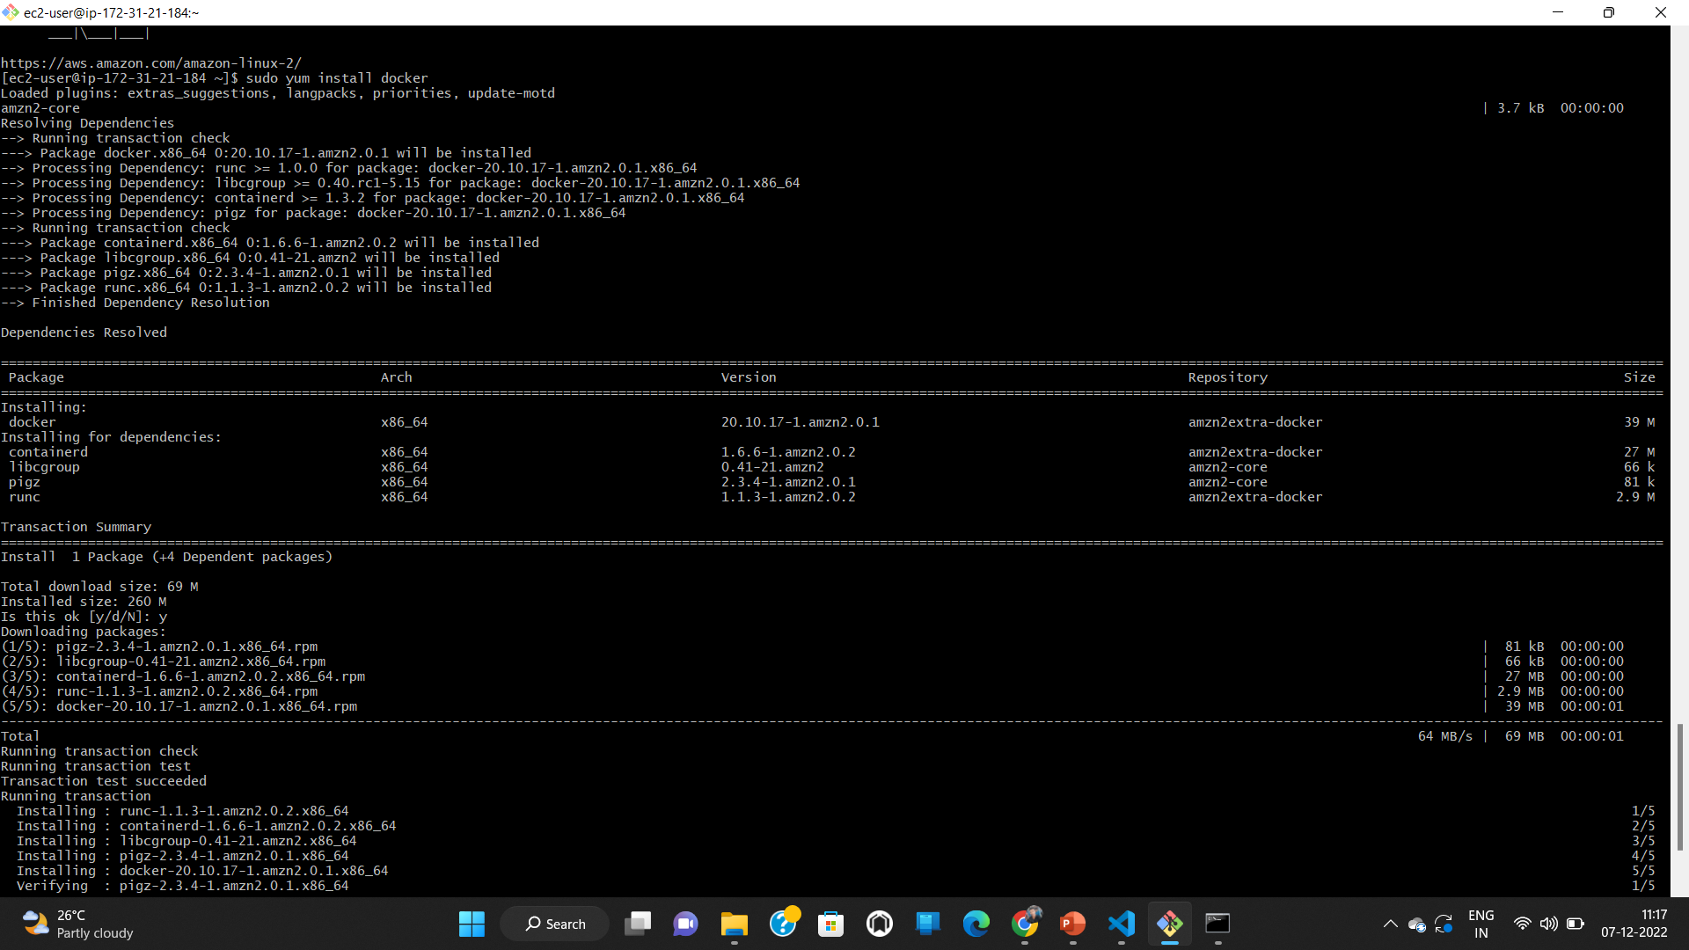
sudo yum install docker

Slide 16
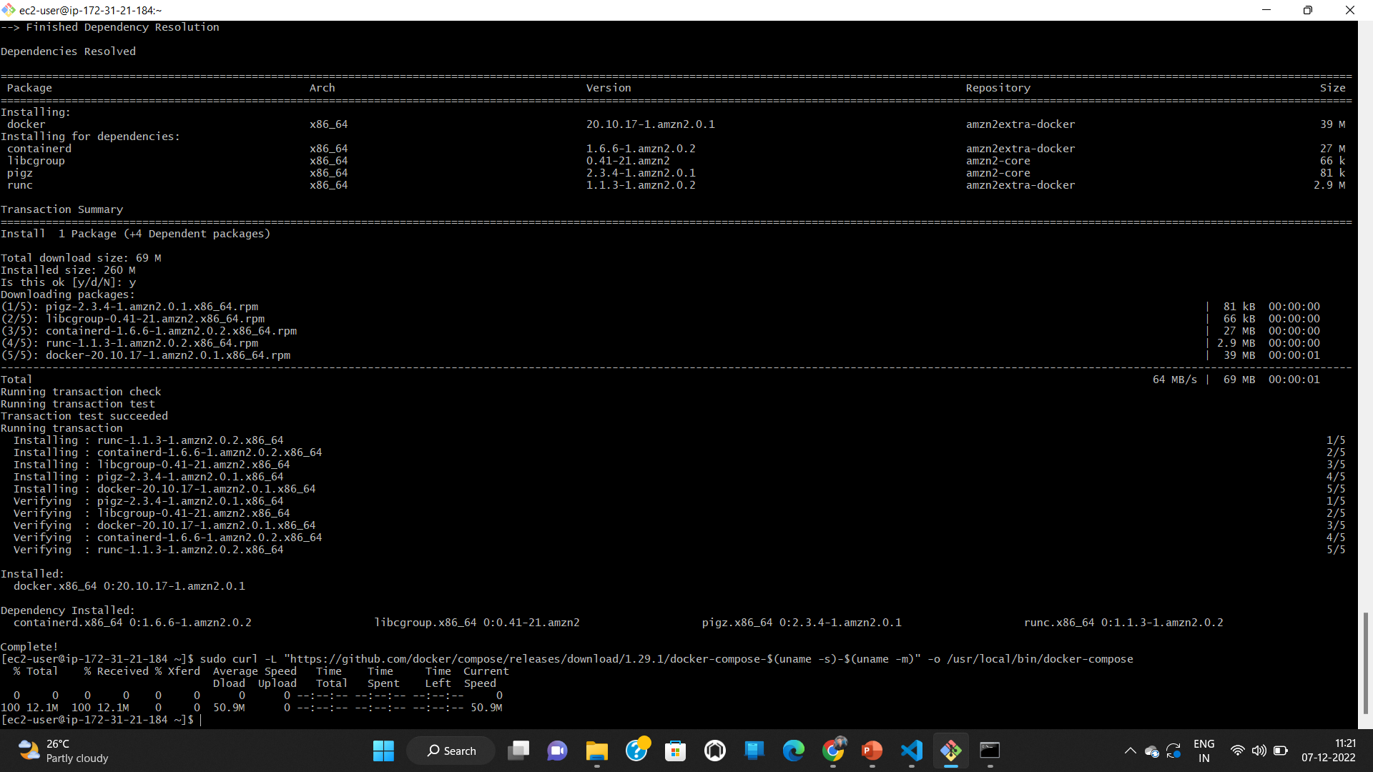
sudo curl -L "https://github.com/docker/compose/releases/download/1.29.1/docker-compose-$(uname -s)-$(uname -m)" -o /usr/local/bin/docker-compose

Slide 17
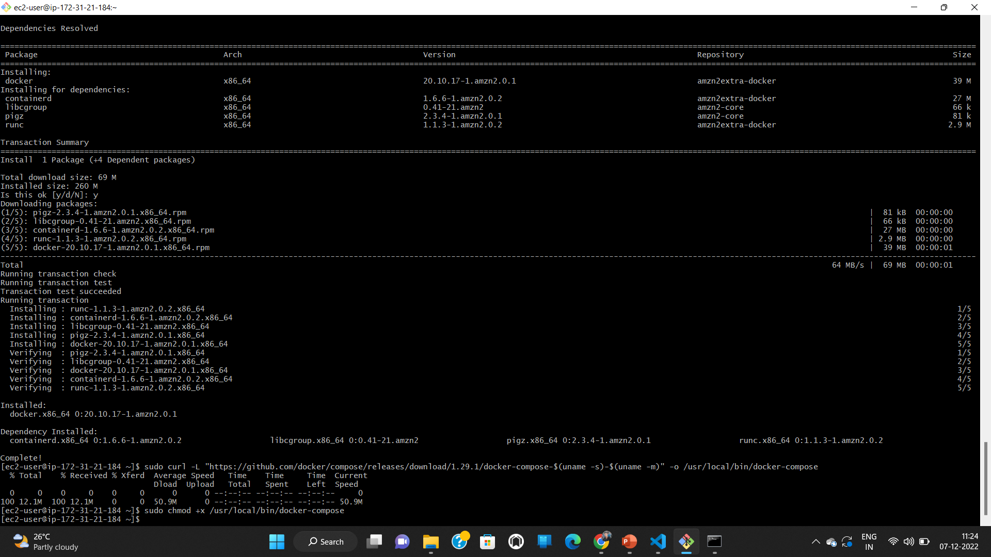
sudo chmod +x /usr/local/bin/docker-compose

Slide 18
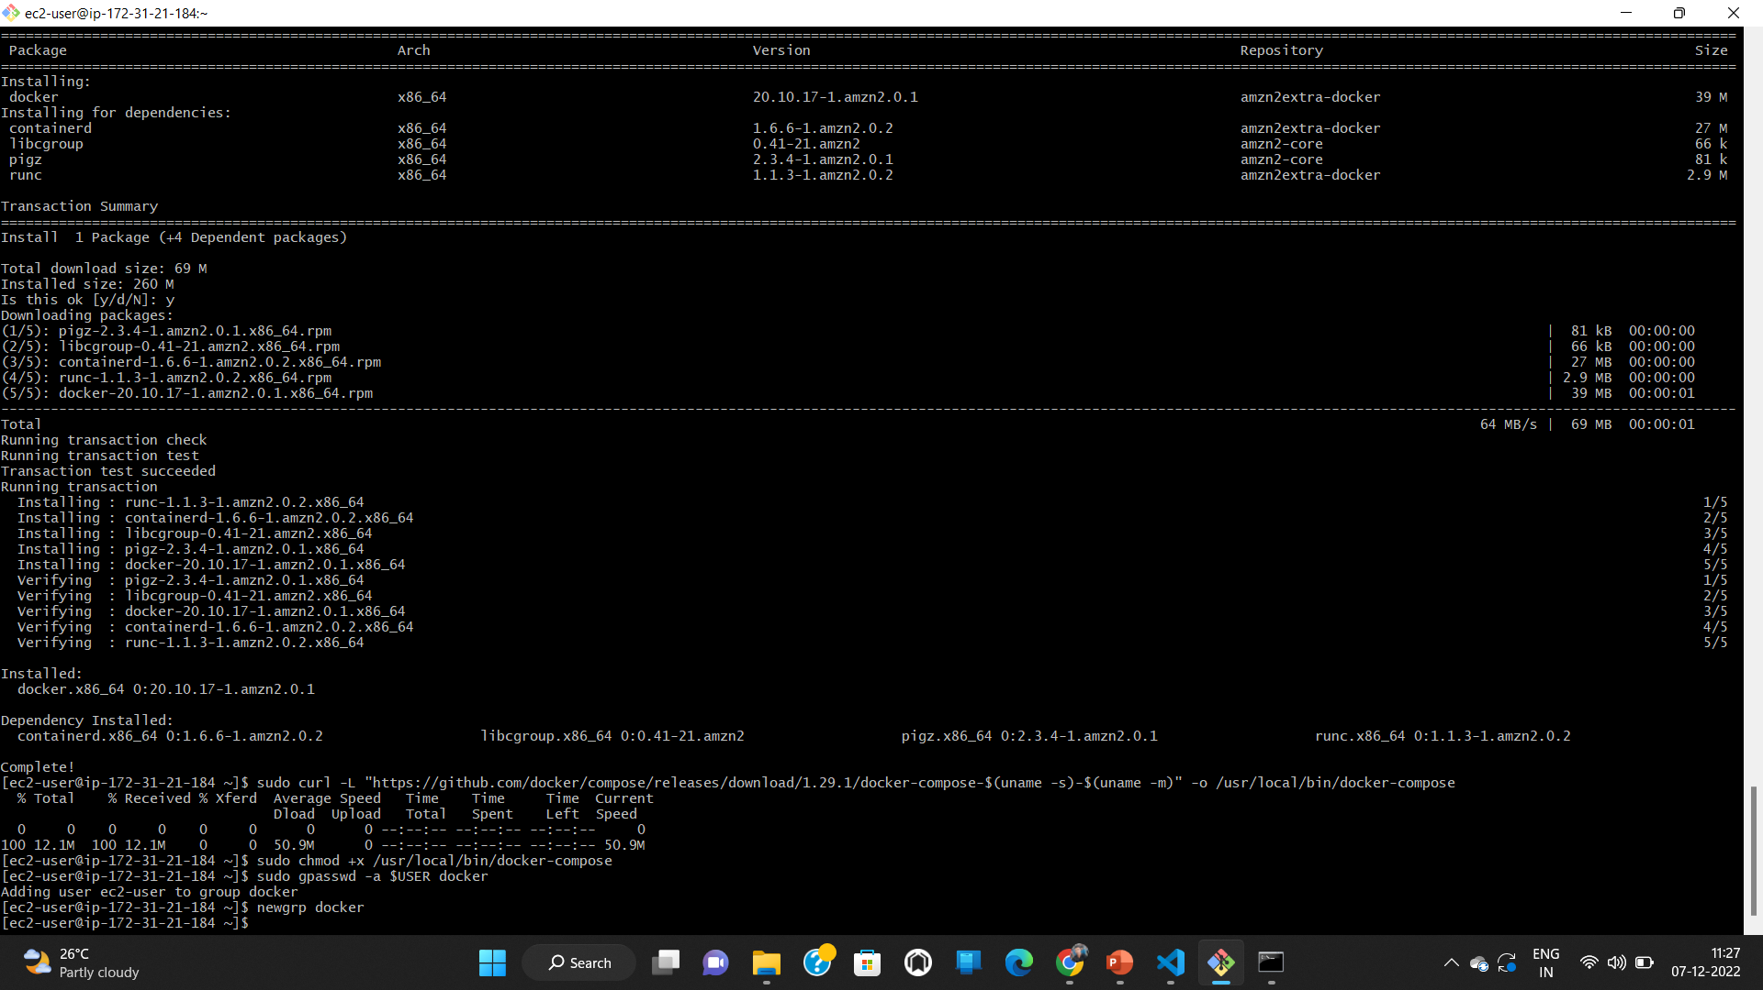
Make current user as the sudo sudo gpasswd -a $USER docker newgrp docker

Slide 19
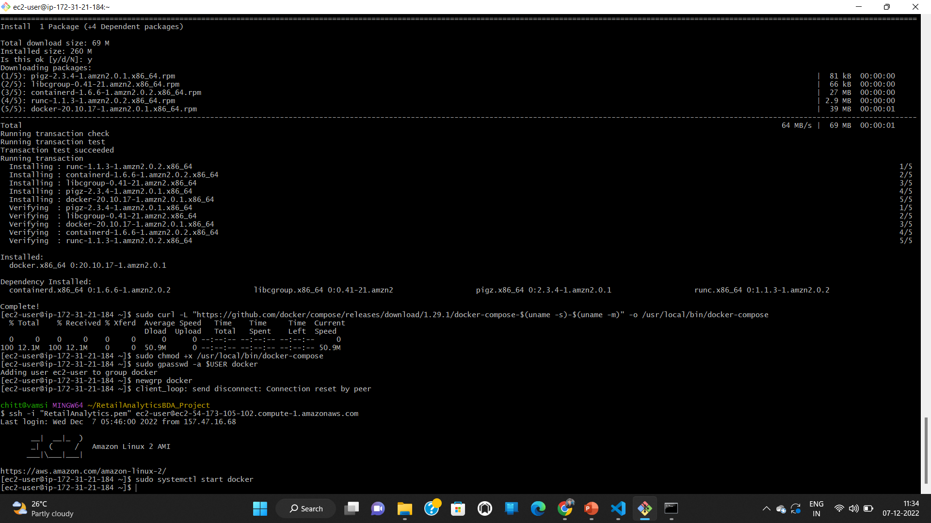
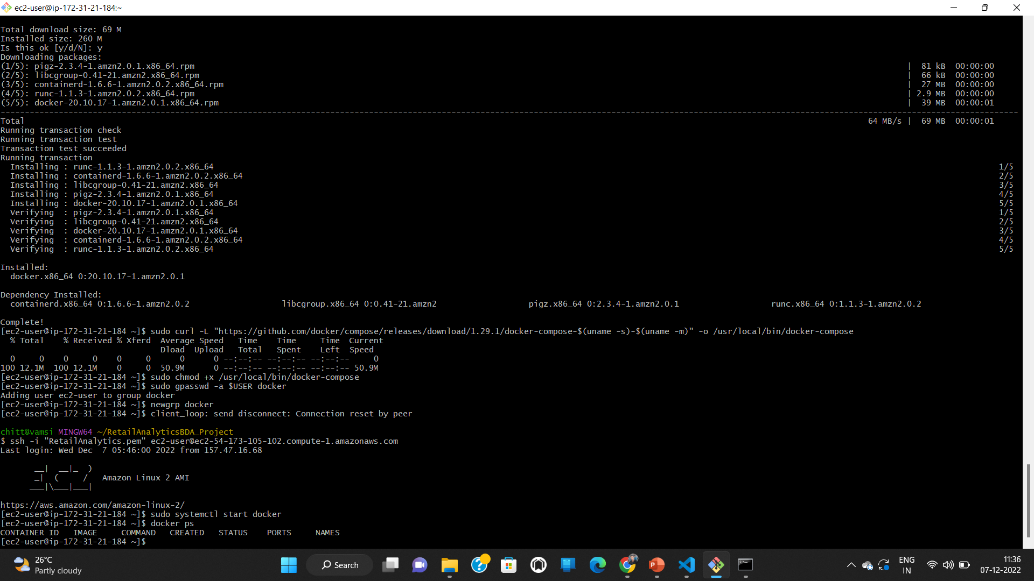
Start the docker
No containers are running currently

Slide 20
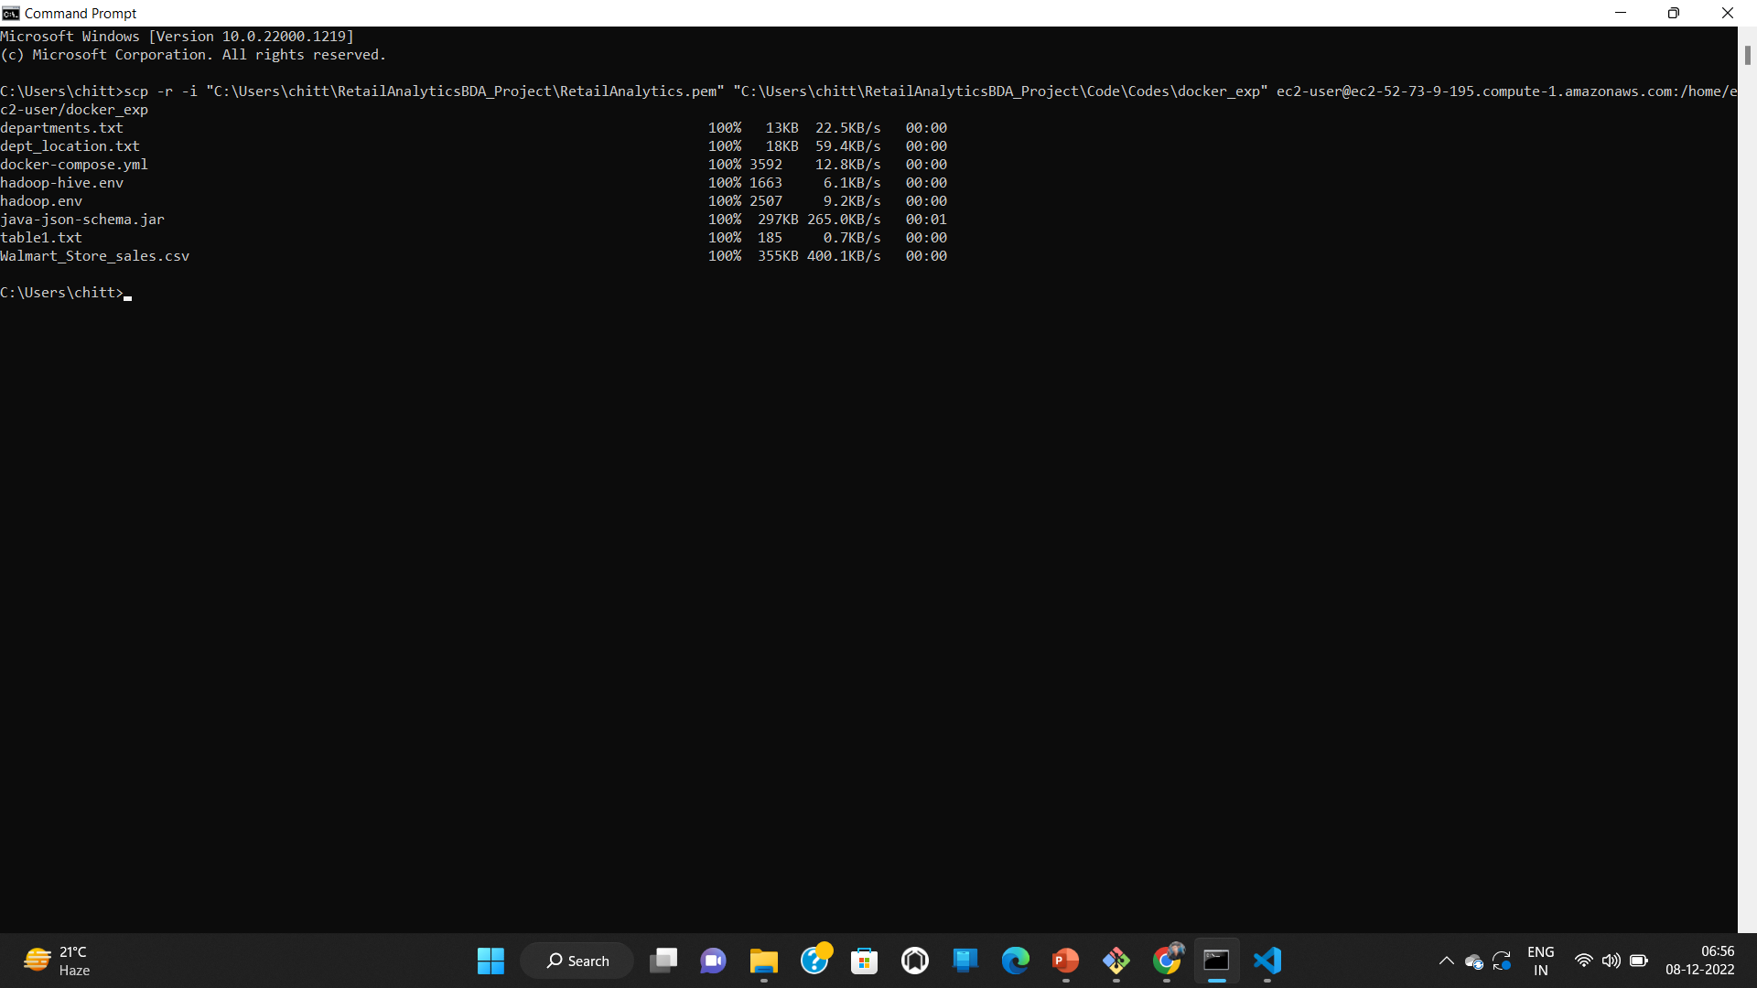
Migrating MySQL data to Hive
Copy Dataset to the instance

Slide 21
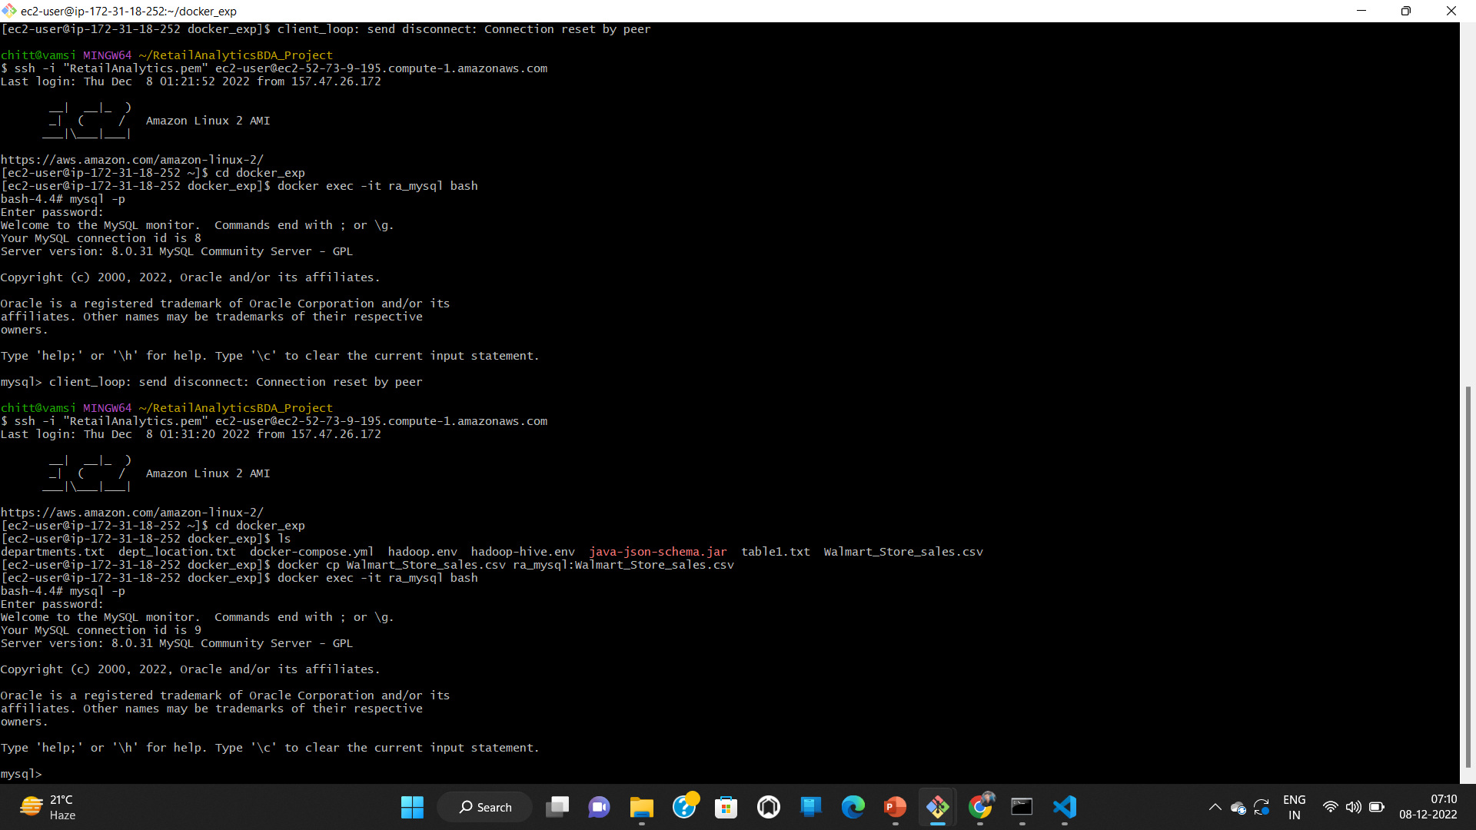
Download dataset into MySQL

Slide 22
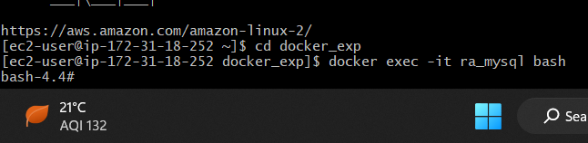
Login bash (login to the container) docker exec -it ra_mysql bash

Slide 23
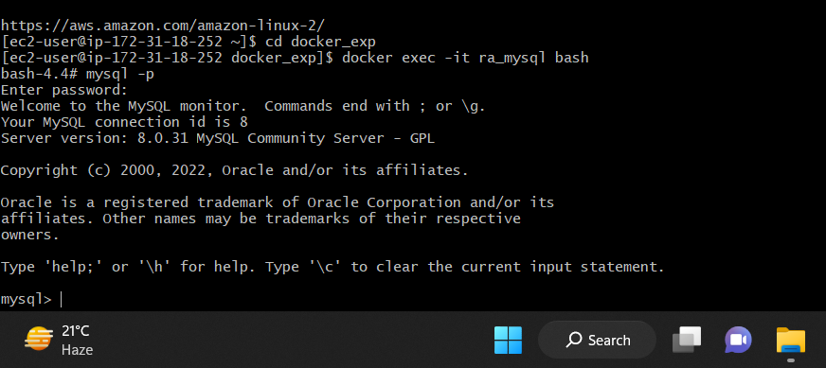
Login to MySQL mysql -p (type example when passsword prompted)

Slide 24
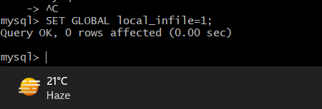
Allow MySQL to get data from local files SET GLOBAL local_infile=1; After setting logout and login again mysql --local-infile=1 -p

Slide 25
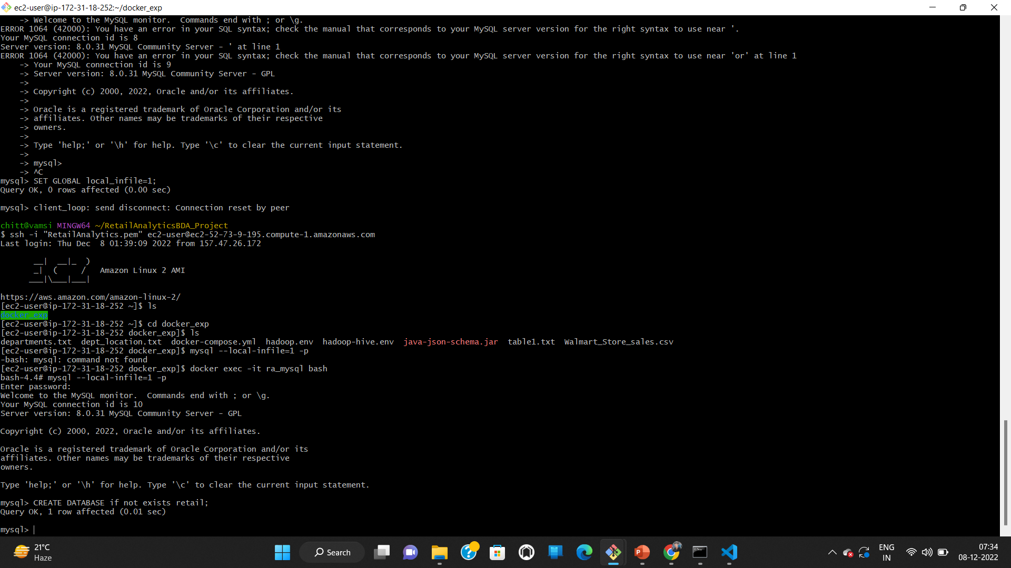
Create a DataBase CREATE DATABASE if not exists retail;

Slide 26
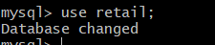
Change database use retail;

Slide 27
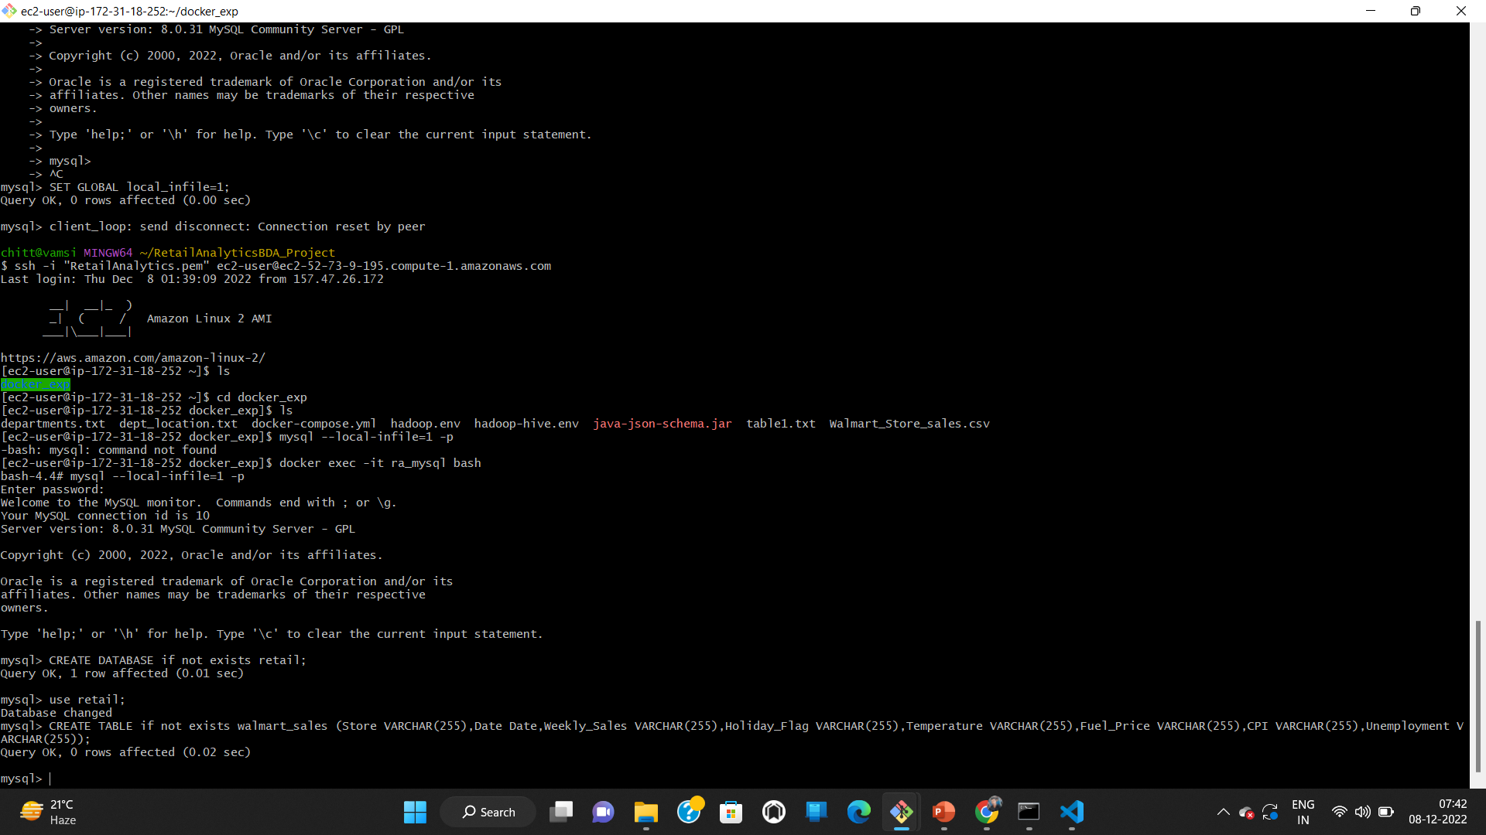
Create table retail CREATE TABLE if not exists walmart_sales (Store VARCHAR(255),Date Date,Weekly_Sales VARCHAR(255),Holiday_Flag VARCHAR(255),Temperature VARCHAR(255),Fuel_Price VARCHAR(255),CPI VARCHAR(255),Unemployment VARCHAR(255));

Slide 28
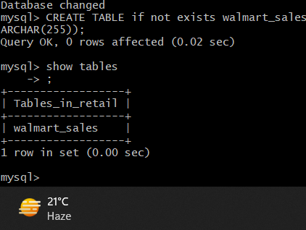
Show tables show tables;

Slide 29
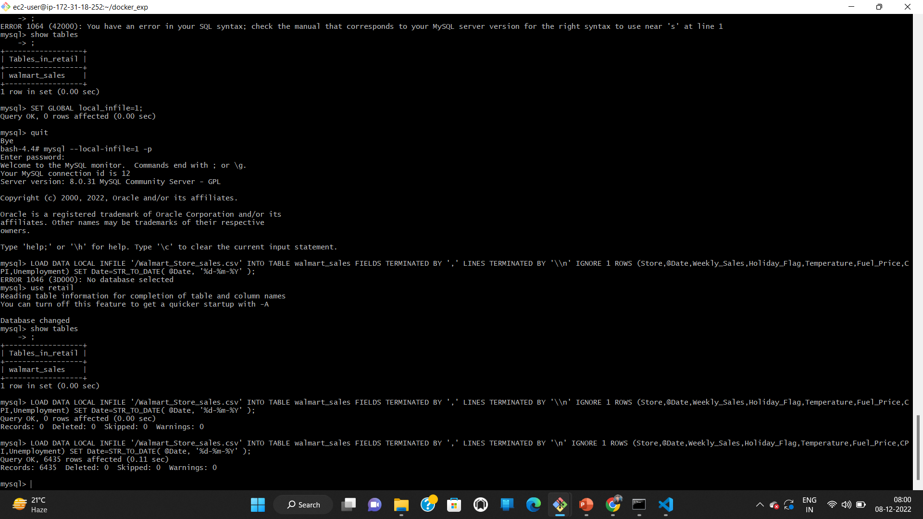
Load csv file into MySQL table LOAD DATA LOCAL INFILE '/Walmart_Store_sales.csv' INTO TABLE walmart_sales FIELDS TERMINATED BY ',' LINES TERMINATED BY '\n' IGNORE 1 ROWS (Store,@Date,Weekly_Sales,Holiday_Flag,Temperature,Fuel_Price,CPI,Unemployment) SET Date=STR_TO_DATE( @Date, '%d-%m-%Y' );

Slide 30
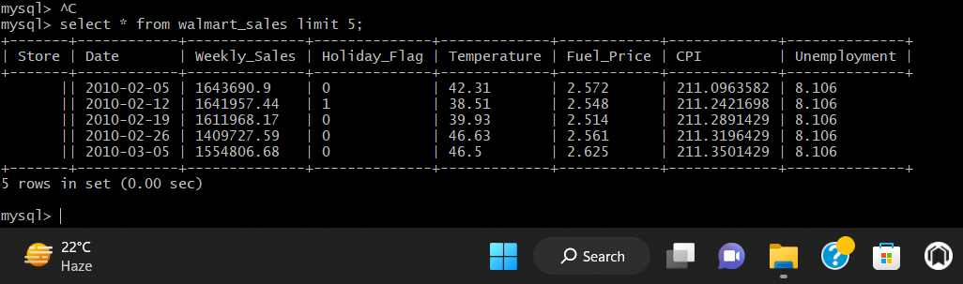
Loading top 5 records from Walmart_sales select * from walamart_sales limit 5;

Slide 31
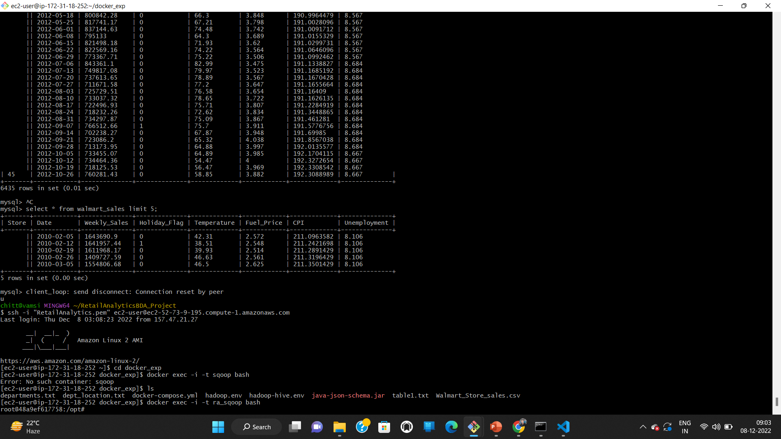
Login to sqoop

Slide 32
Sqoop import job creation
sqoop job --create retail_job \\
-- import \\
--connect jdbc:mysql://mysql:3306/retail \\
--username root \\
--password example \\
--table walmart_sales \\
--fields-terminated-by "," \\
--hive-import \\
--hive-table raw_sales \\
--hive-overwrite \\
--m 1 \\
--incremental append \\
--check-column Date \\
--last-value '1900-01-01'

Slide 33
Loading the data in the MYSQL walmart_sales table to the Hive table raw_sales.
Hive doesn’t support updates so last modified is not supported.
We use incremental append to load the records from walamart_sales to raw sales if new records are inserted.
Using check-column we indicate the sqoop the column to look out and using last-value we mention till what point we have already processed the data.
We are using a single mapper “-m 1”

Slide 34
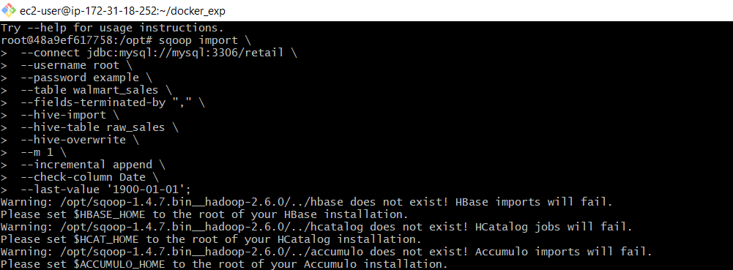
Import SQL data using sqoop

Slide 35
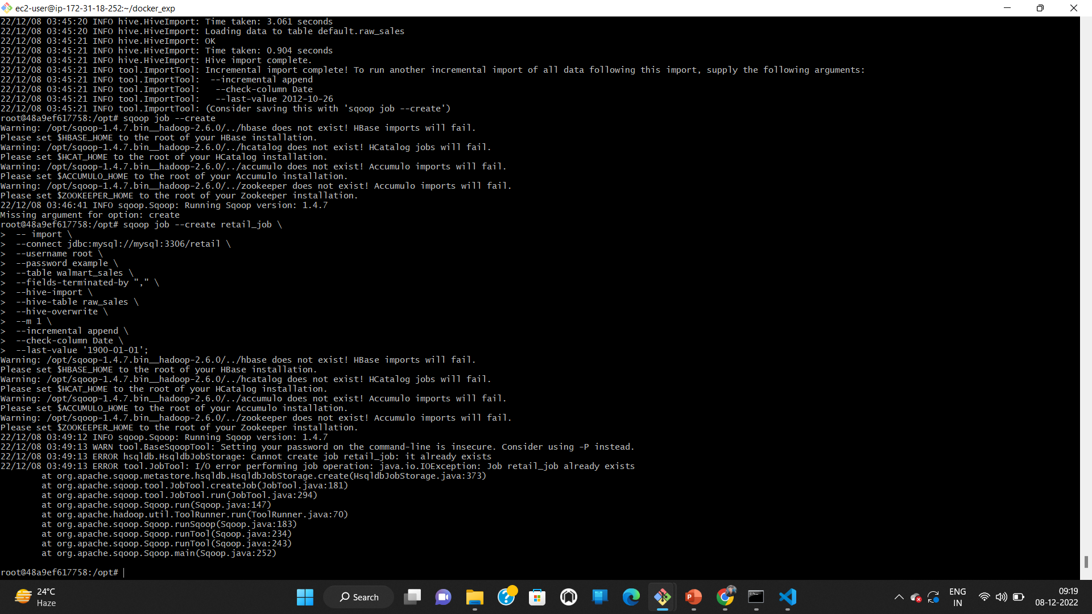
Sqoop job creation

Slide 36
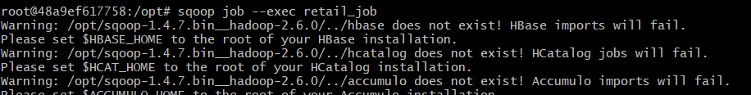
Execute the sqoop job sqoop job --exec retail_job

Slide 37
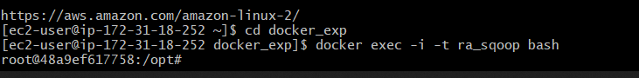
Login to Hive docker exec -i -t ra_sqoop bash

Slide 38
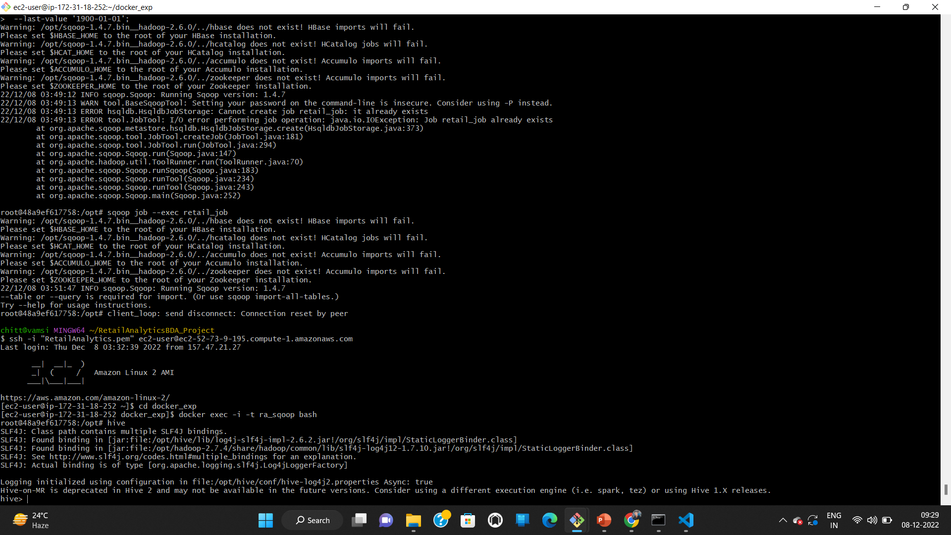

Slide 39
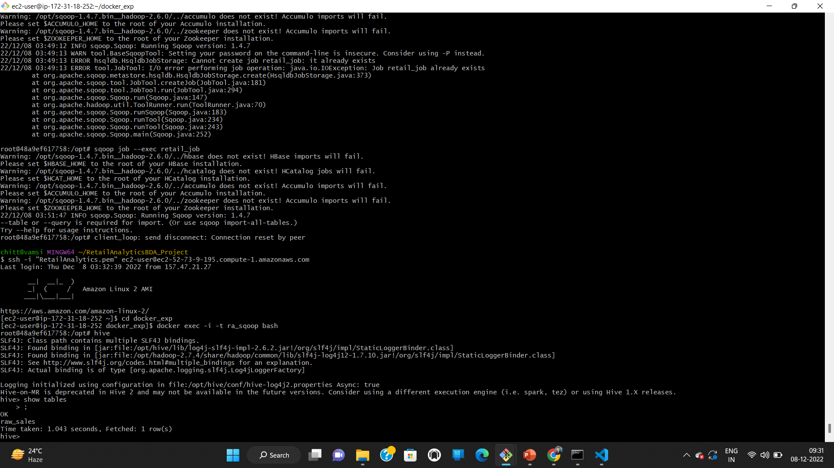
Show tables

Slide 40
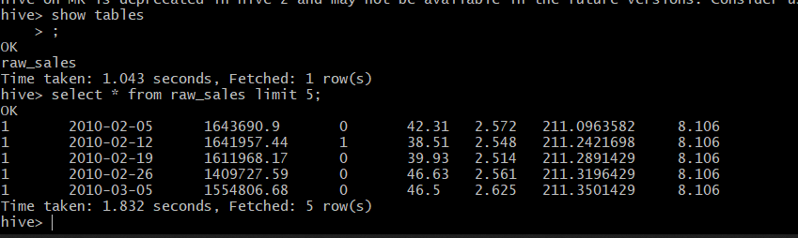
Load top 5 records select * from raw_sales limit 5;

Slide 41
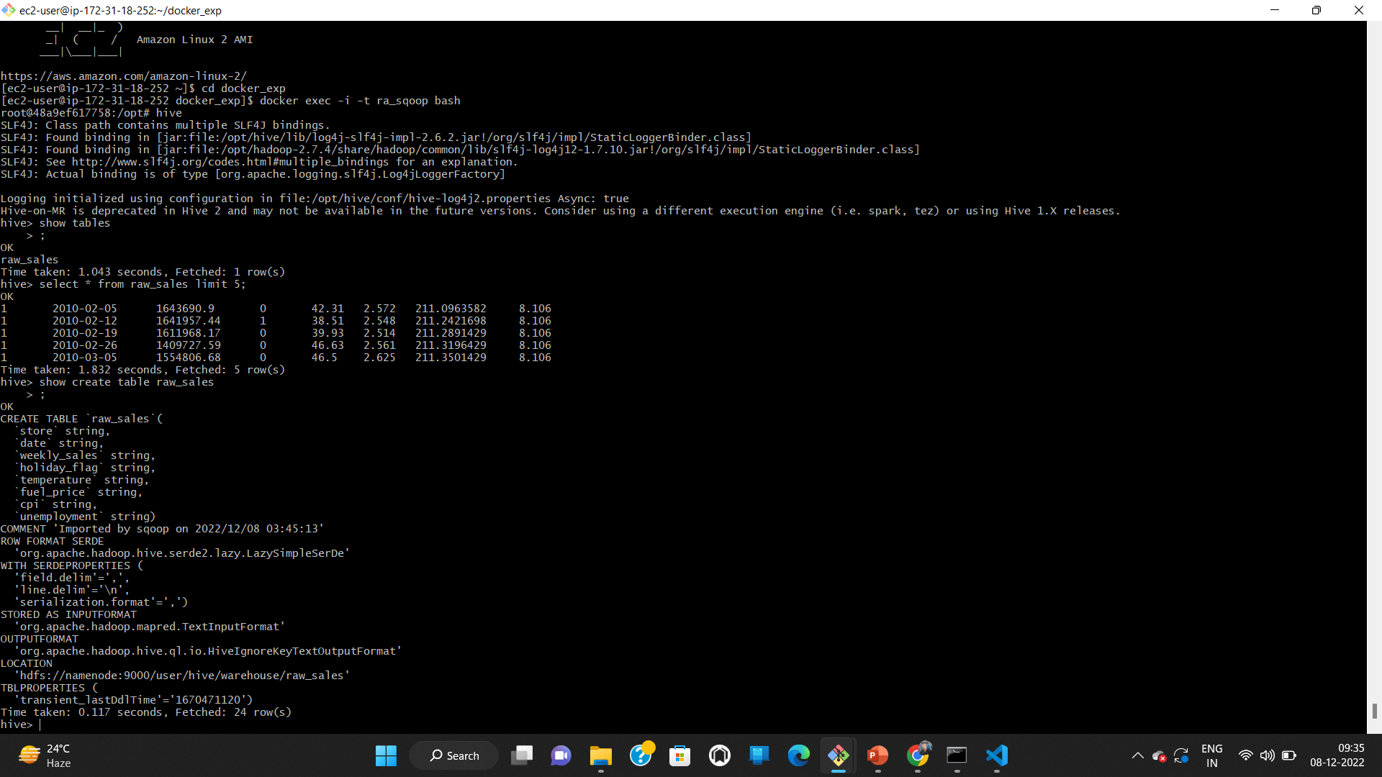
Location of table show create table raw_sales
We see that the table is created at
“hdfs://namenode:9000/user/hive/warehouse/raw_sales”

Slide 42
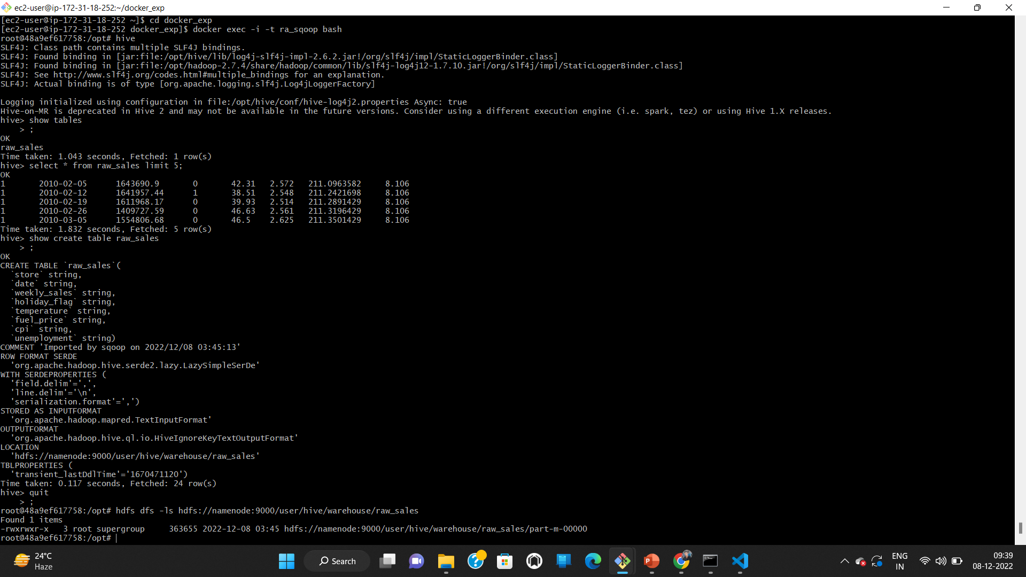
Locating the file in HDFS
We are using only 1 mapper hence only 1 file is created

Slide 43
Transformation and load Final table creation
beeline
!connect jdbc:hive2://127.0.0.1:10000 scott tiger
create database if not exists retail;
use retail;
create table walmart_sales as
select
cast(Store as int),
cast(to_date(from_unixtime(unix_timestamp(`Date`, 'yyyy-MM-dd'))) as date) as date_of_entry,
cast(Weekly_Sales as double),
Holiday_Flag,
cast(Temperature as float),
cast(fuel_price as float),
cast(cpi as double),
cast(Unemployment as float)
from default.raw_sales;

Slide 44
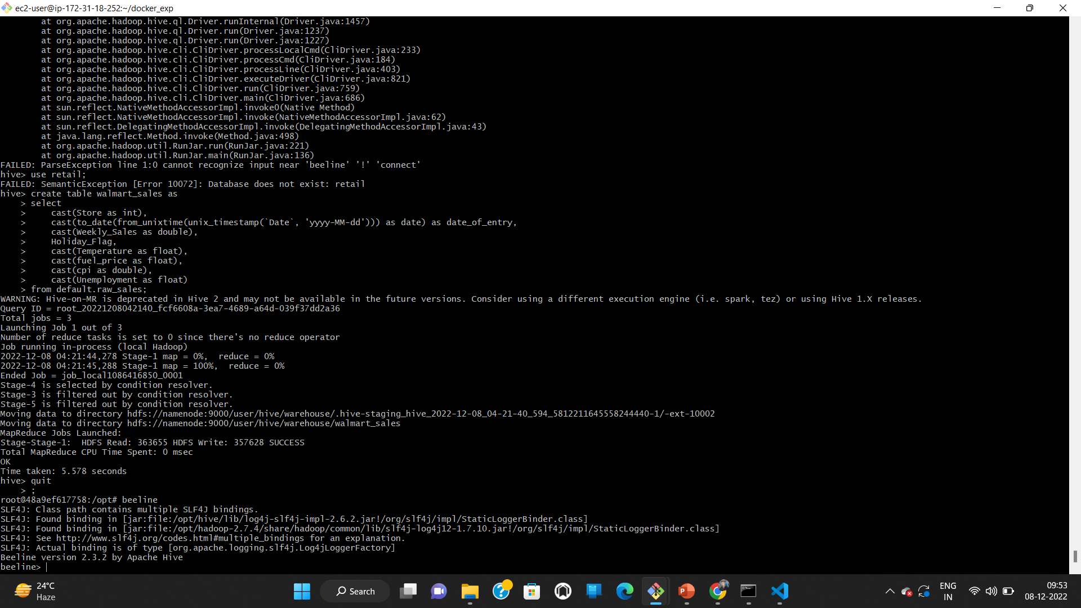
Login to beeline

Slide 45
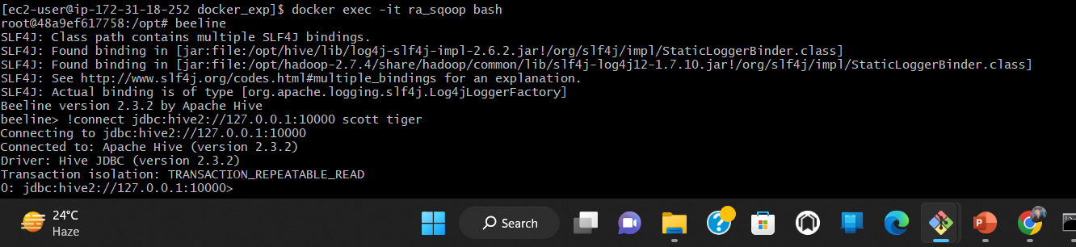
Give connection string !connect jdbc:hive2://127.0.0.1:10000 scott tiger
We are trying to connect to Hive server on this IP address

Slide 46
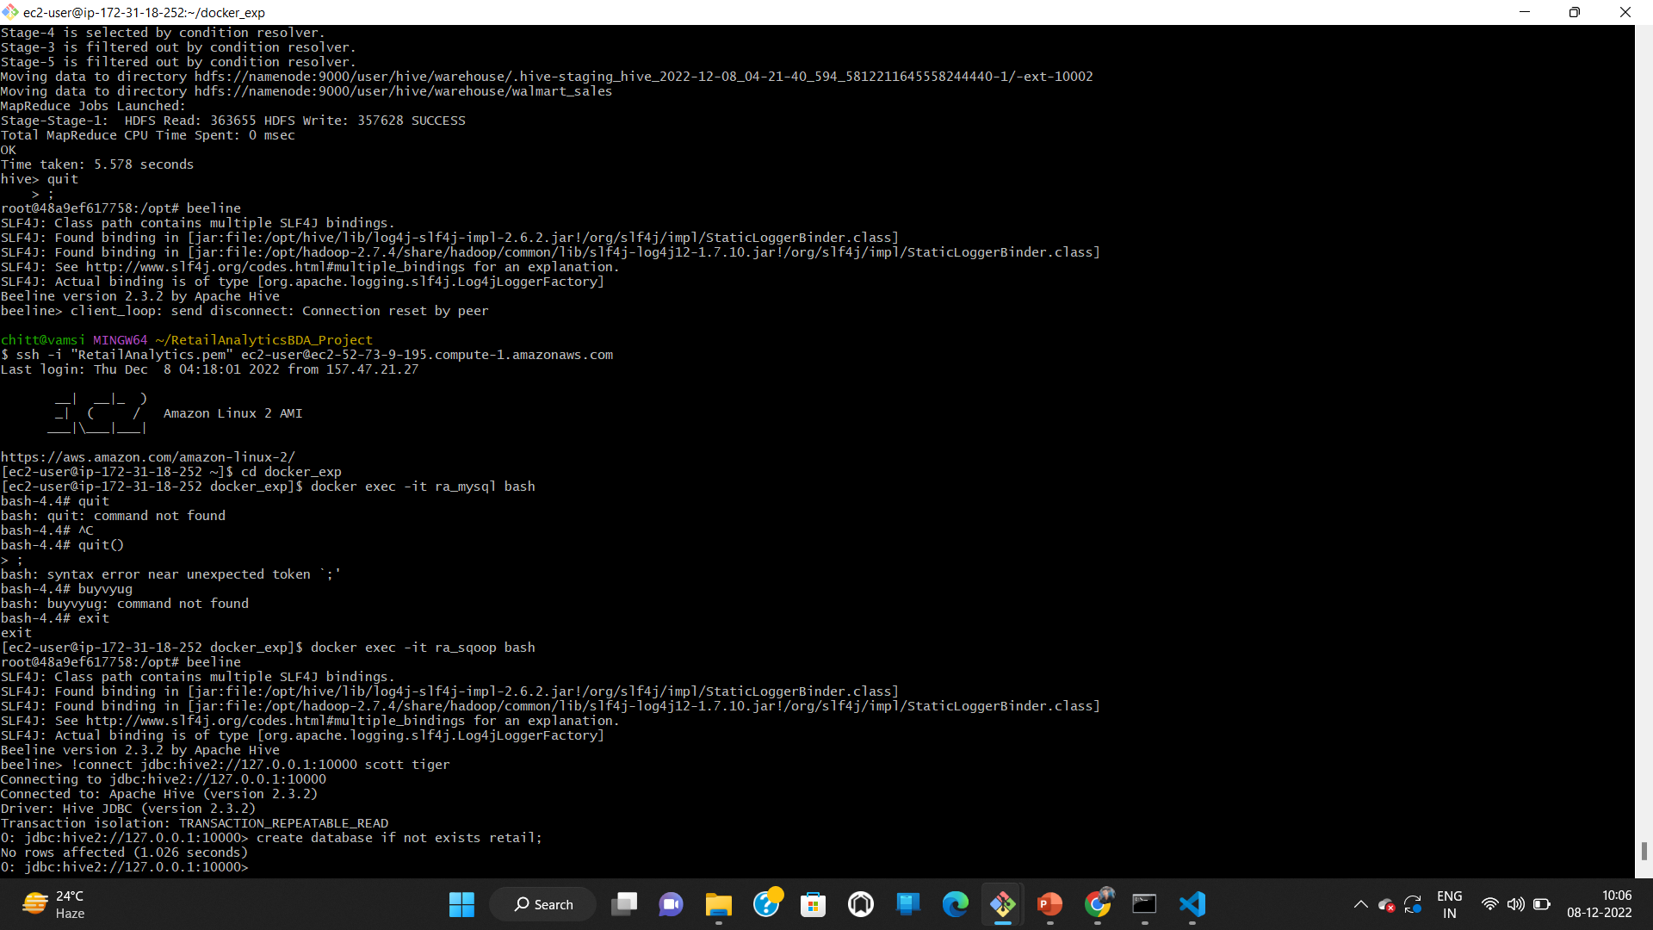
Create a database create database if not exists retail;

Slide 47
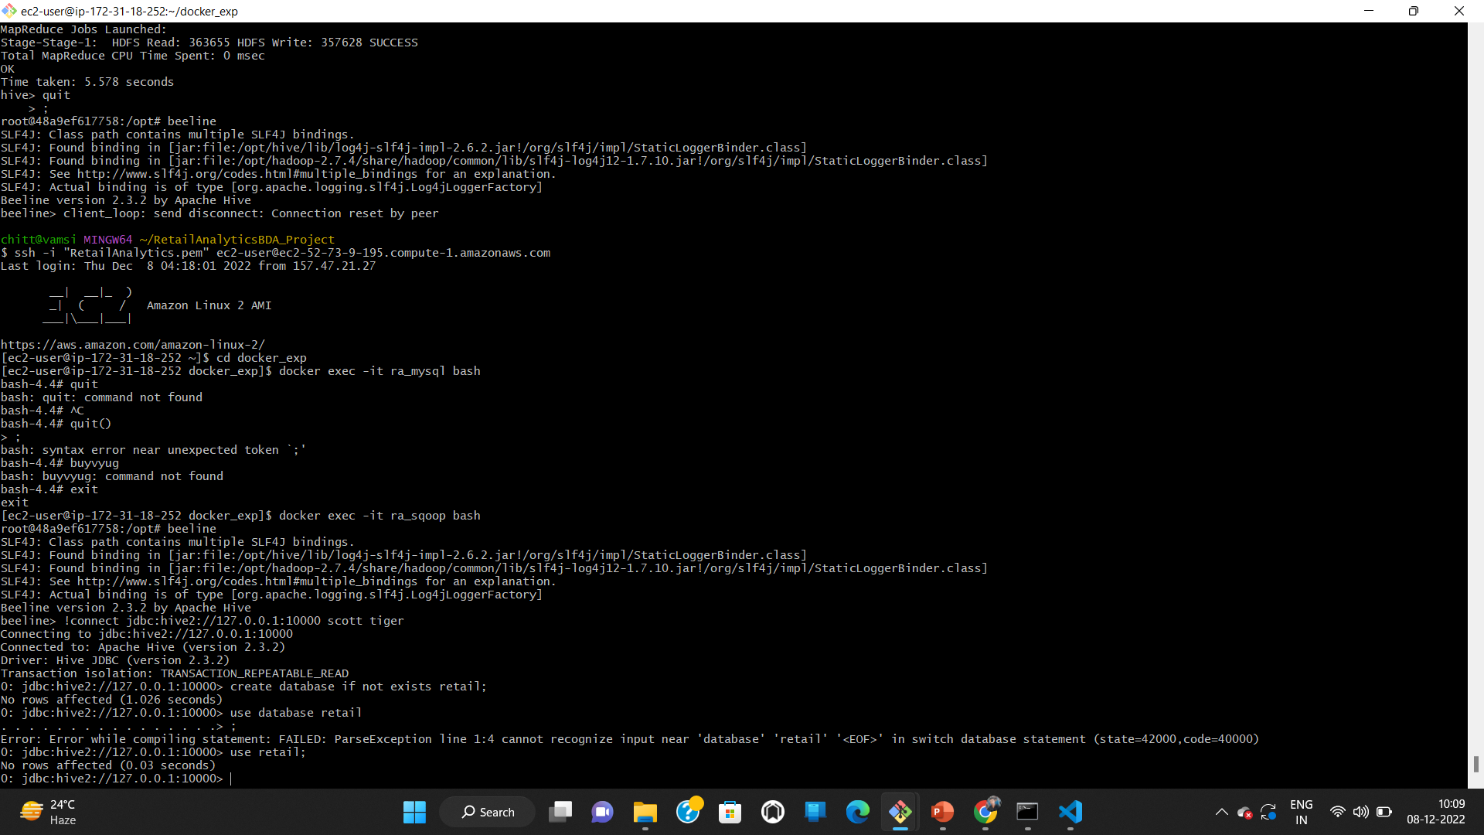
Use created database use retail;

Slide 48
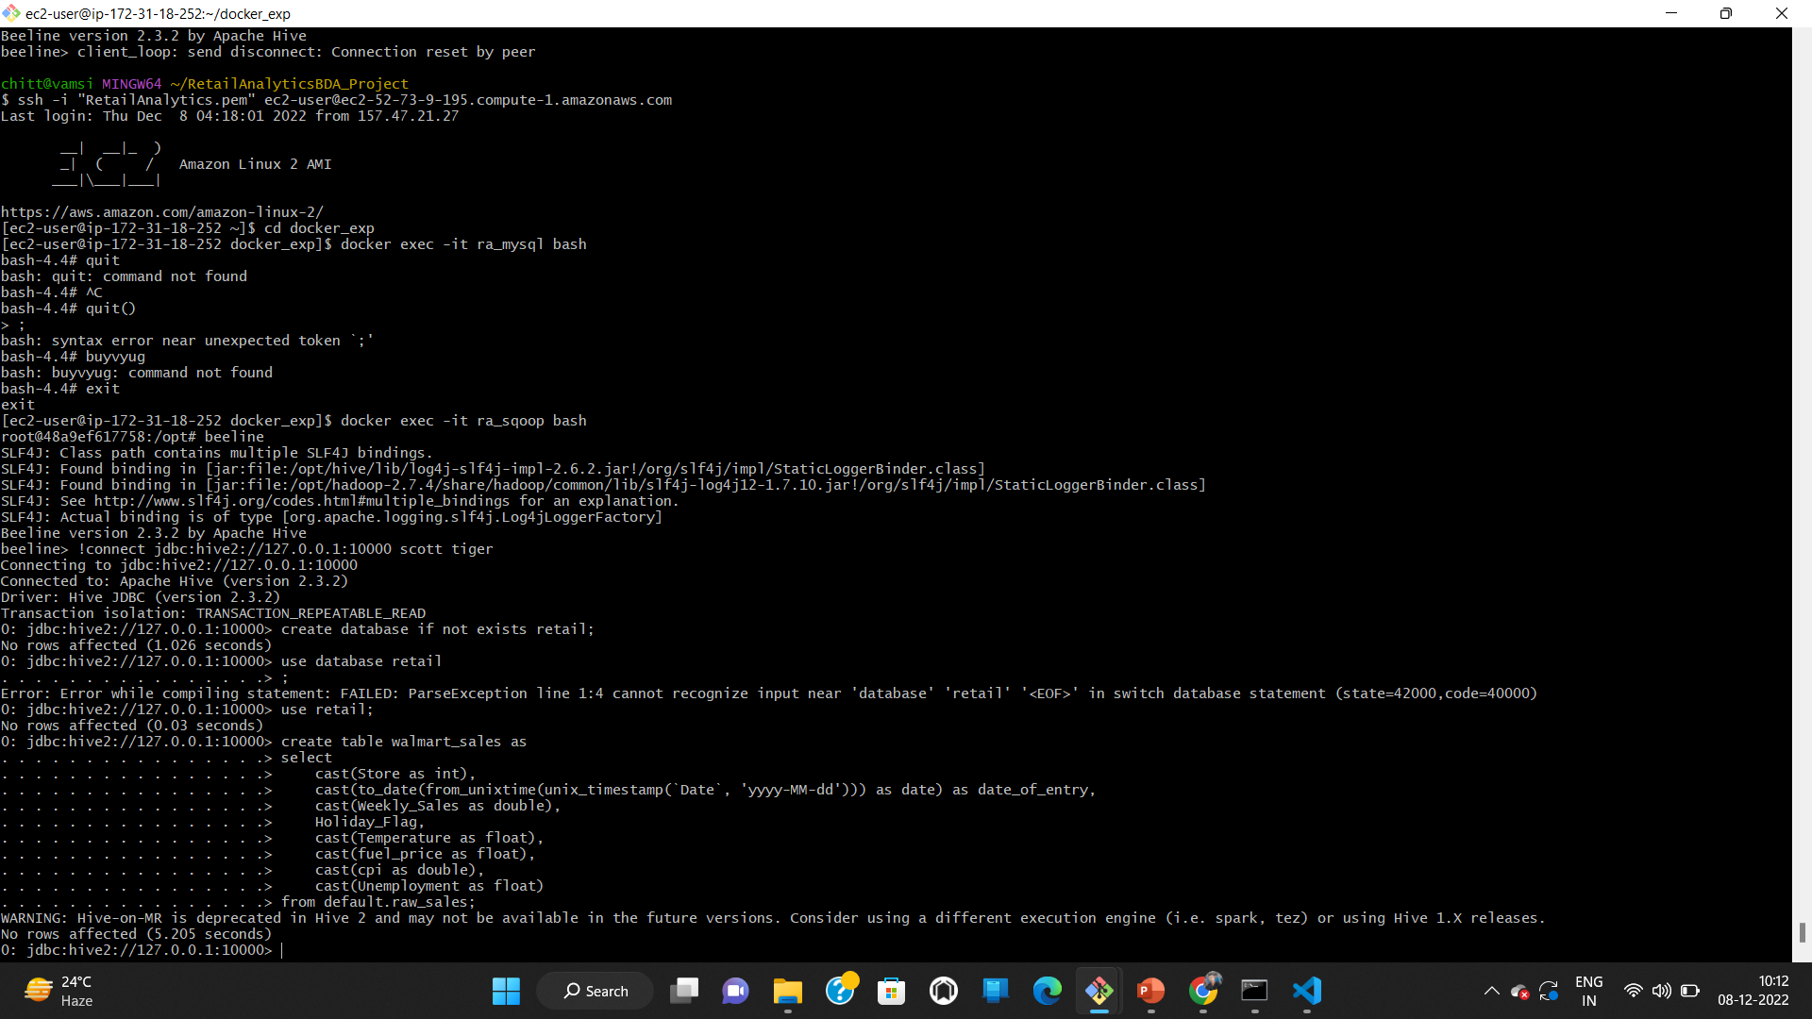
Create table
In raw table we have all column types as string .Here we cast them into their respective datatypes in the final table.

Slide 49
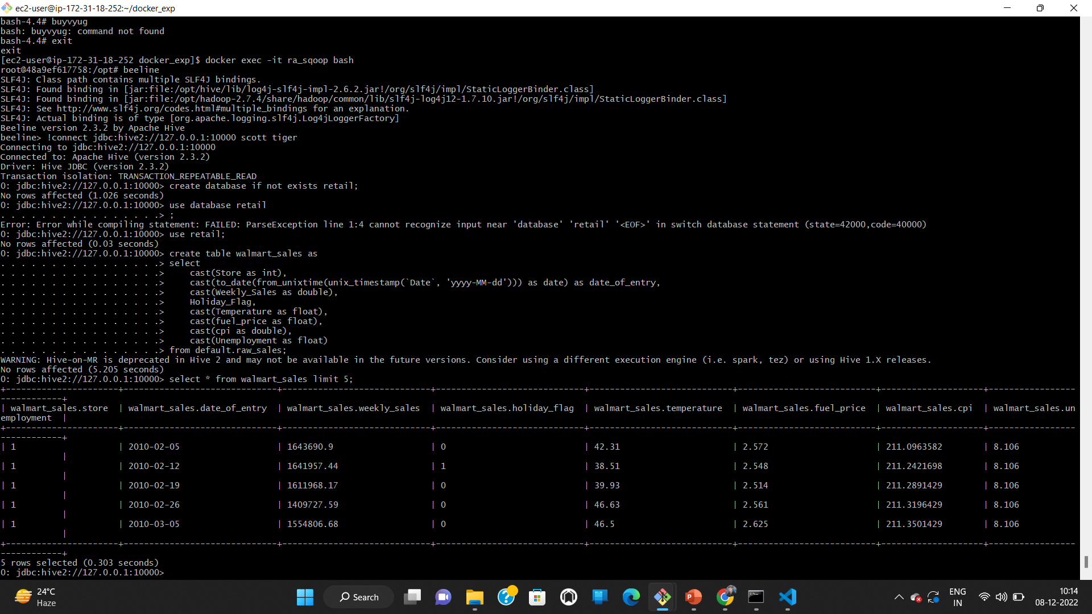
Show top 5 records from Walmart_sales select * from walmart_sales limit 5

Slide 50
Analytics : Queries to answer questions
Which store has minimum and maximum sales?
Store 20 has the maximum sales
Store 33 has the minimum sales

Slide 51
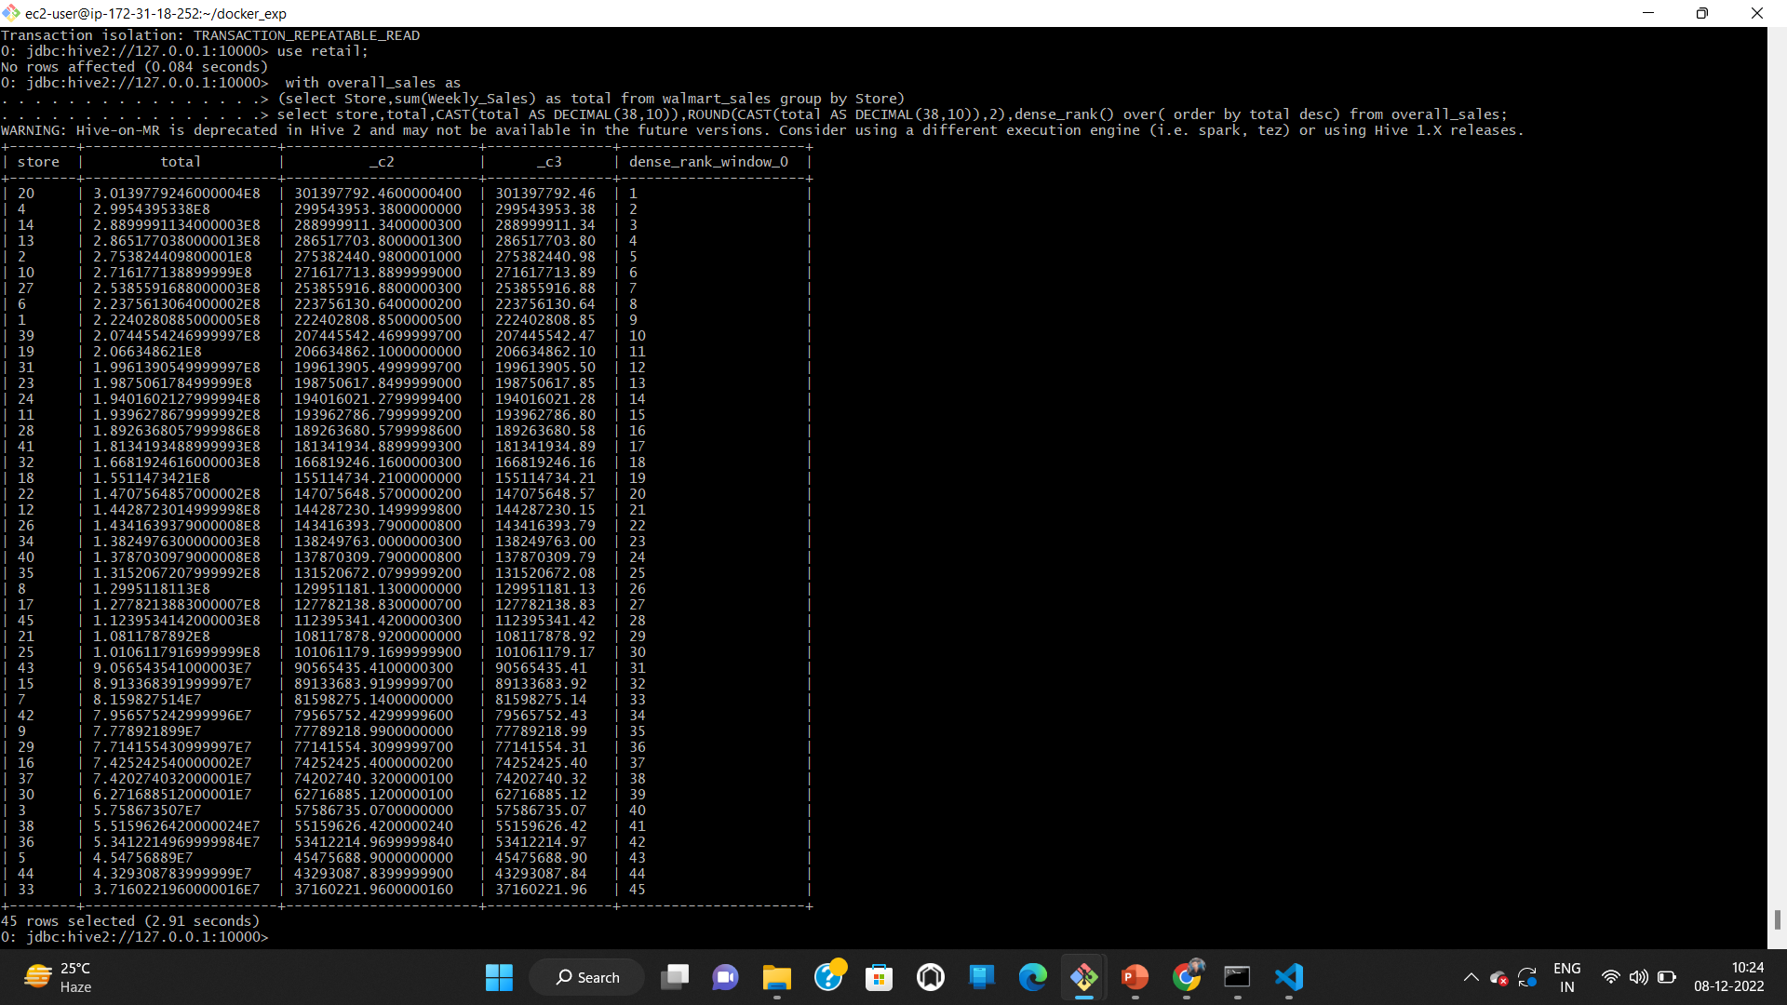

Slide 52
Which store has maximum standard deviation?
Store 14 has the highest standard deviation

Slide 53
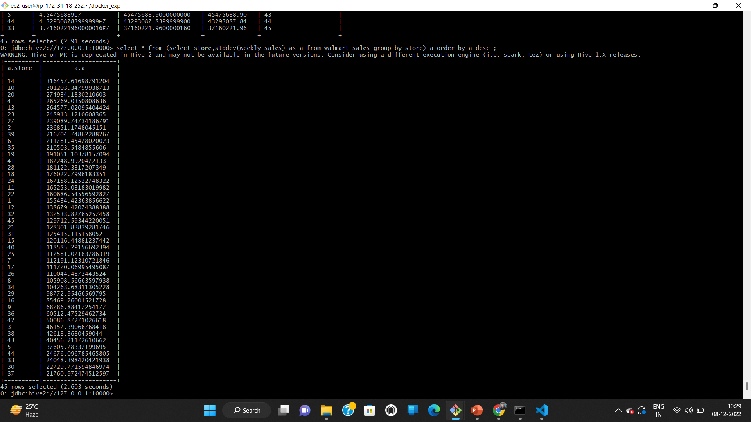

Slide 54
Coefficient of mean to standard deviation?
This gives us an idea on how much the sales are deviating with respect to mean

Slide 55
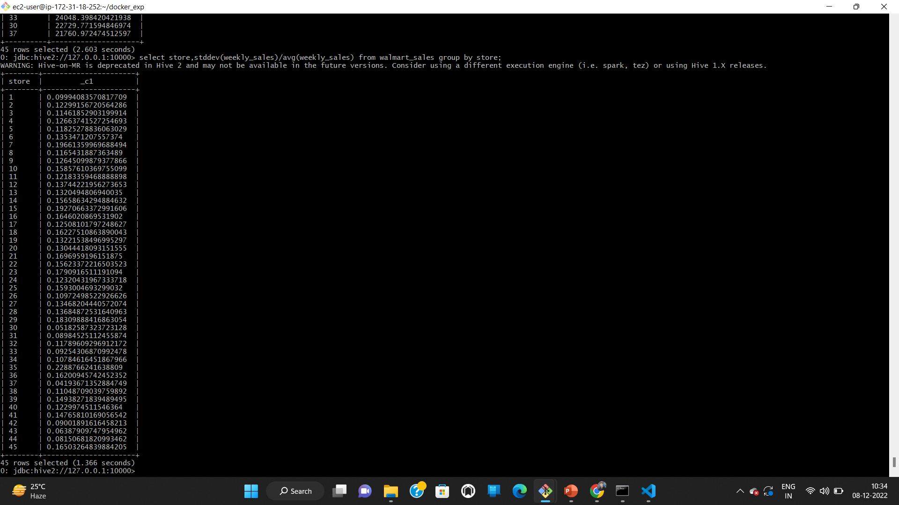

Slide 56
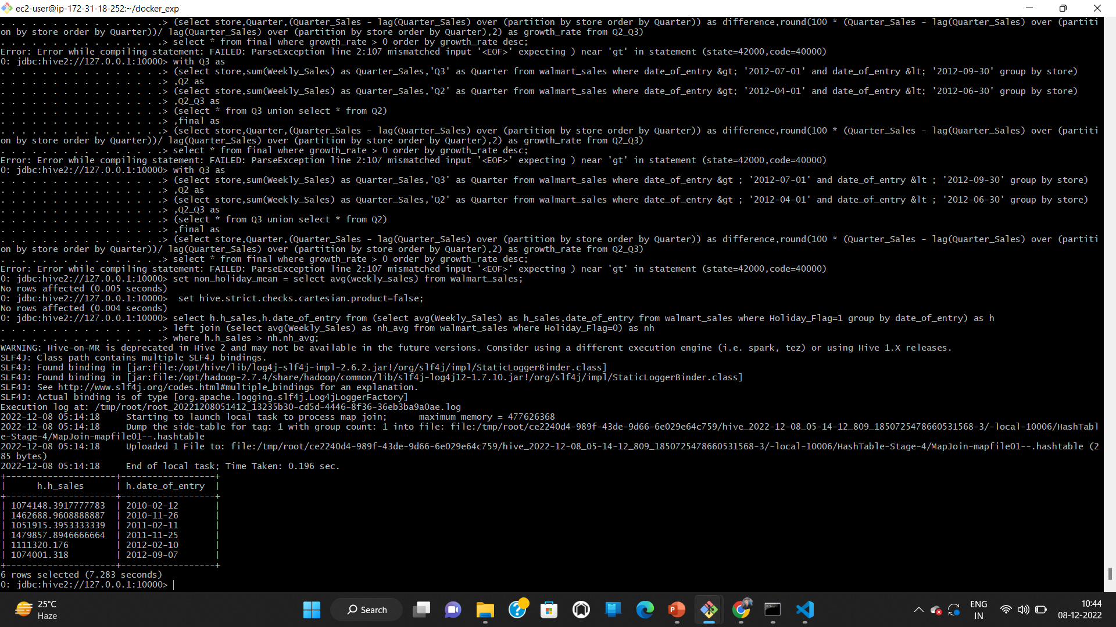
Find out holidays which have higher sales than the mean sales in non-holiday season for all stores together.
set non_holiday_mean = select avg(weekly_sales) from walmart_sales;
set hive.strict.checks.cartesian.product=false;
select h.h_sales,h.date_of_entry from (select avg(Weekly_Sales) as h_sales,date_of_entry from walmart_sales where Holiday_Flag=1 group by date_of_entry) as h
left join (select avg(Weekly_Sales) as nh_avg from walmart_sales where Holiday_Flag=0) as nh
where h.h_sales > nh.nh_avg;

